Slide 1
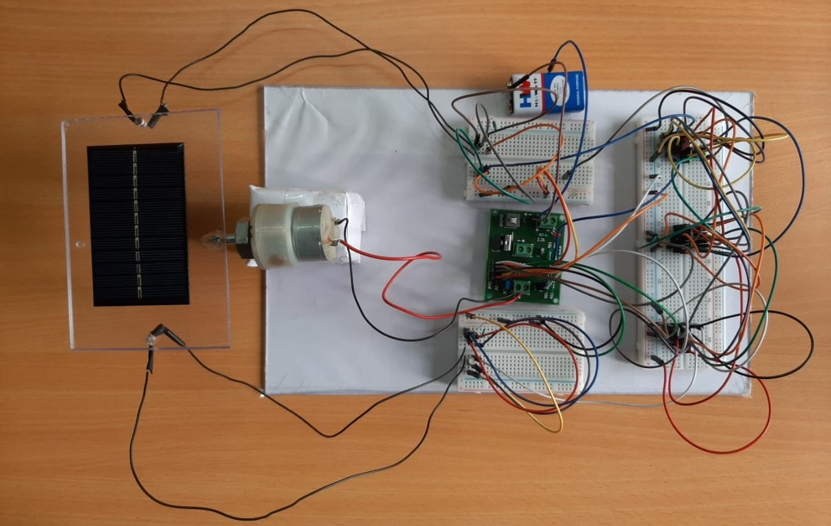

SINGLE AXIS SOLAR TRACKING SYSTEM
B.M.S COLLEGE OF ENGINEERING
Bull Temple Road, Basavanagudi , Bangalore - 560 019, Karnataka, India
TEAM MEMBERS
Subramanya K - 1BM18EC154
Suraj S - 1BM18EC160
V .A .R. Karthik - 1BM18EC174
Sukshith B Jain - 1BM18EC156
Under the guidance of
Assistant Professor
Pooja A P
MINI PROJECT
2019 – 20
DEPARTMENT OF ELECTRONICS AND COMMUNICATION ENGINEERING

Slide 2
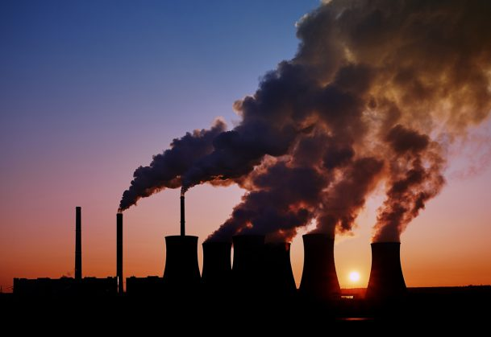
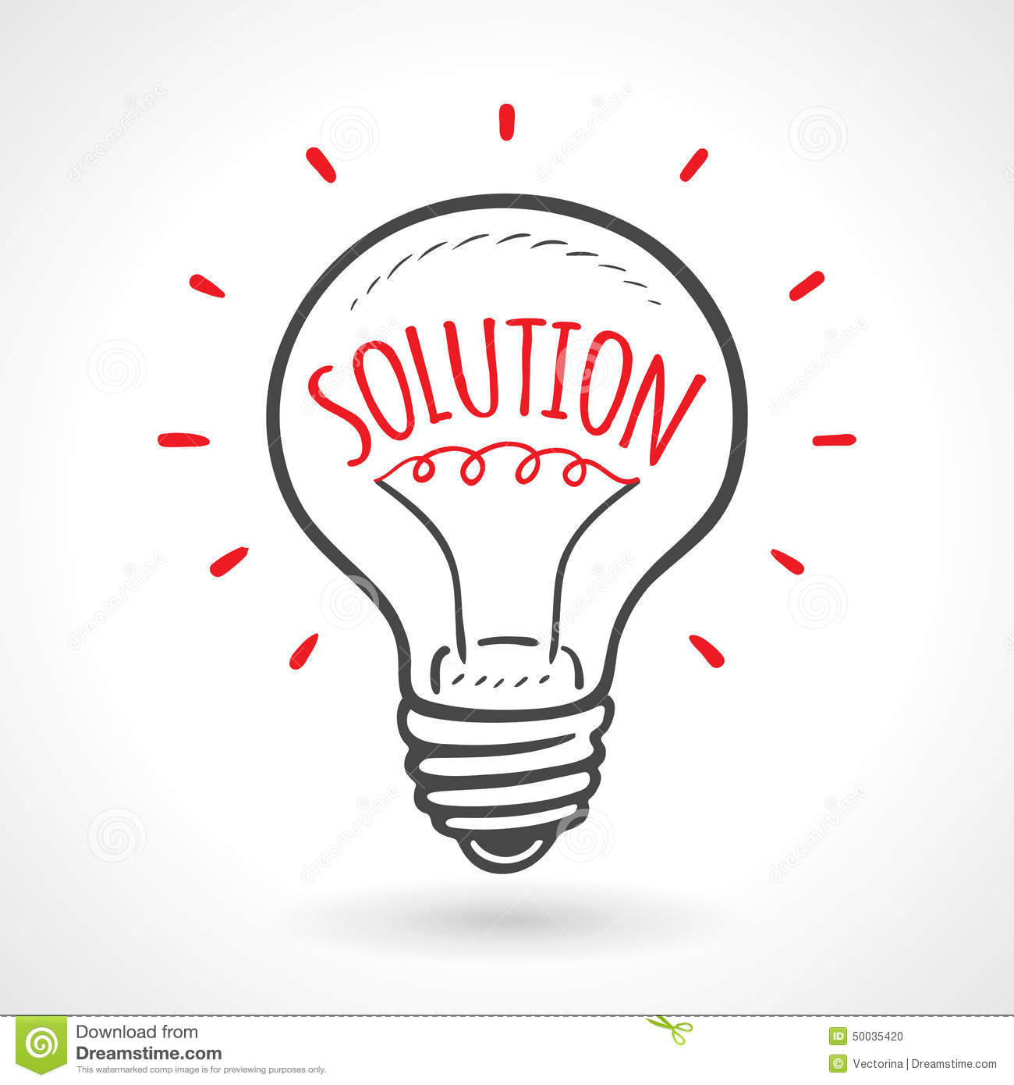
INTRODUCTION
In the present world pollution is the main Problem.
If we keep burning fossil fuels at our current rate, it is estimated that all our fossil fuels will be depleted by 2060.
The burning of fossil fuel gives out harm full gases like sulfur dioxide, Nitrogen oxides ,which combine react with other gases water, oxygen ton cause acidic pollutants , which causes acid rain etc.

Slide 3
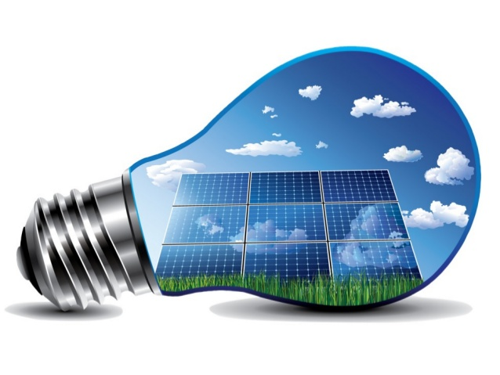
SOLUTION
Solar energy is solution for this problem
It’s a renewable source of energy.
Lots of work is going to improve the efficiency of solar power.

Slide 4
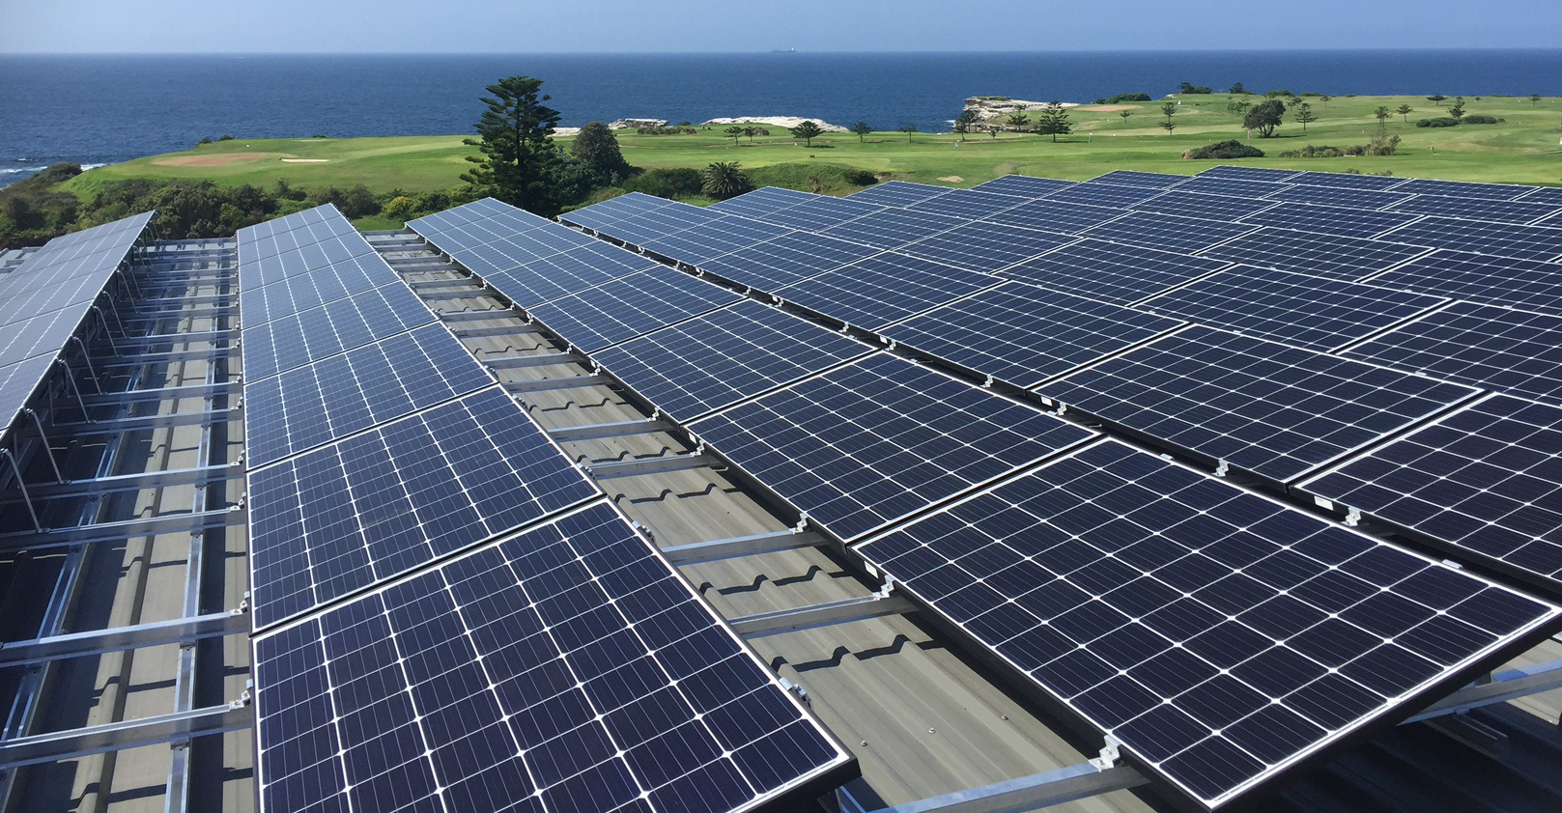
SCOPE OF THE PROJECT
Renewable energy provides reliable power supplies and fuel diversification, Since it is renewable there is high energy security, It will last forever, reducing the need for imported fuels. Maintenance requirements also low. It has numerous health and environmental benefits.

Slide 5
IMPORTANCE:
Photovoltaic solar panels : absorb sunlight as a source of energy to generate direct current electricity.
Solar power is pollution free and causes no greenhouse gases to be emitted after installation and non no generation losses.
Solar energy is more advantages compared to other renewable energy because we can us the solar energy anywhere where there is sun light.

Slide 6
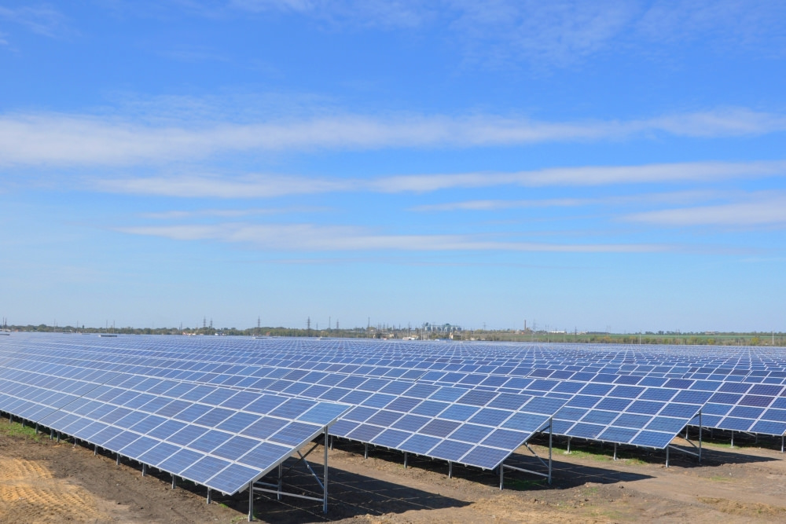
PROBLEM DEFINITION
Although solar energy can still be collected during cloudy and rainy days, the efficiency of the solar system drops.
Solar panels are in fixed position and wasting sunlight.
Solar PV panels require a lot of space and efficiency is restricted to 11-15% .
Lower energy output during sunny conditions.
Fig: Solar Tracker
Larger area and less productivity
Fig: Neural network

Slide 7

OBJECTIVES:
More energy is to be absorbed.
More power output.
To increase it’s efficiency.
RESEARCH AREAS:
Power System Planning to increase efficiency .
Operation with high solar incident with least price possible.

Slide 8
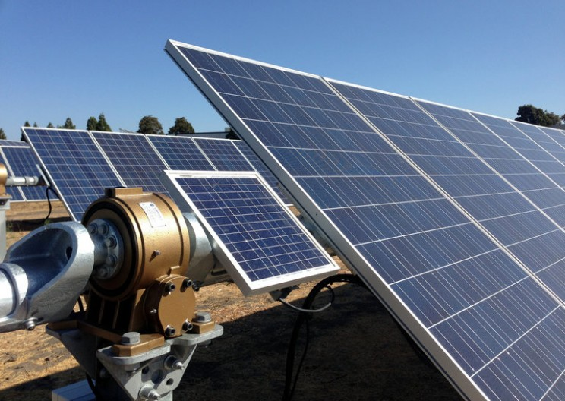
PROPOSED SOLUTION
SOLAR TRACKING
Solar tracker, a system that positions an solar panel at an angle relative to the Sun.
Photovoltaic solar trackers adjust the direction that a solar panel is facing according to the position of the Sun in the sky perpendicularly.

Slide 9
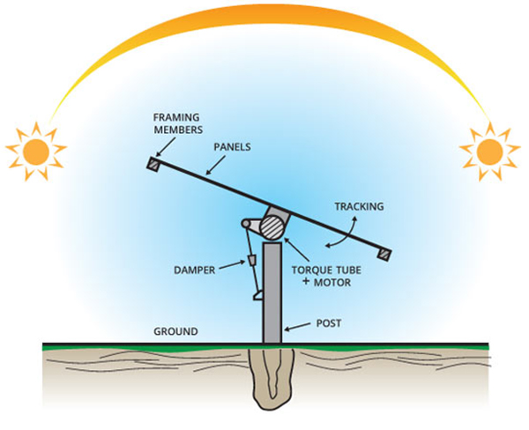
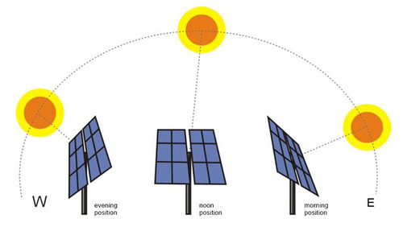
A Solar tracker will make a solar panel around 40 percent more efficient.
Morning it will face in east direction.
Afternoon facing upwards.
Evening it will face in west direction

Slide 10
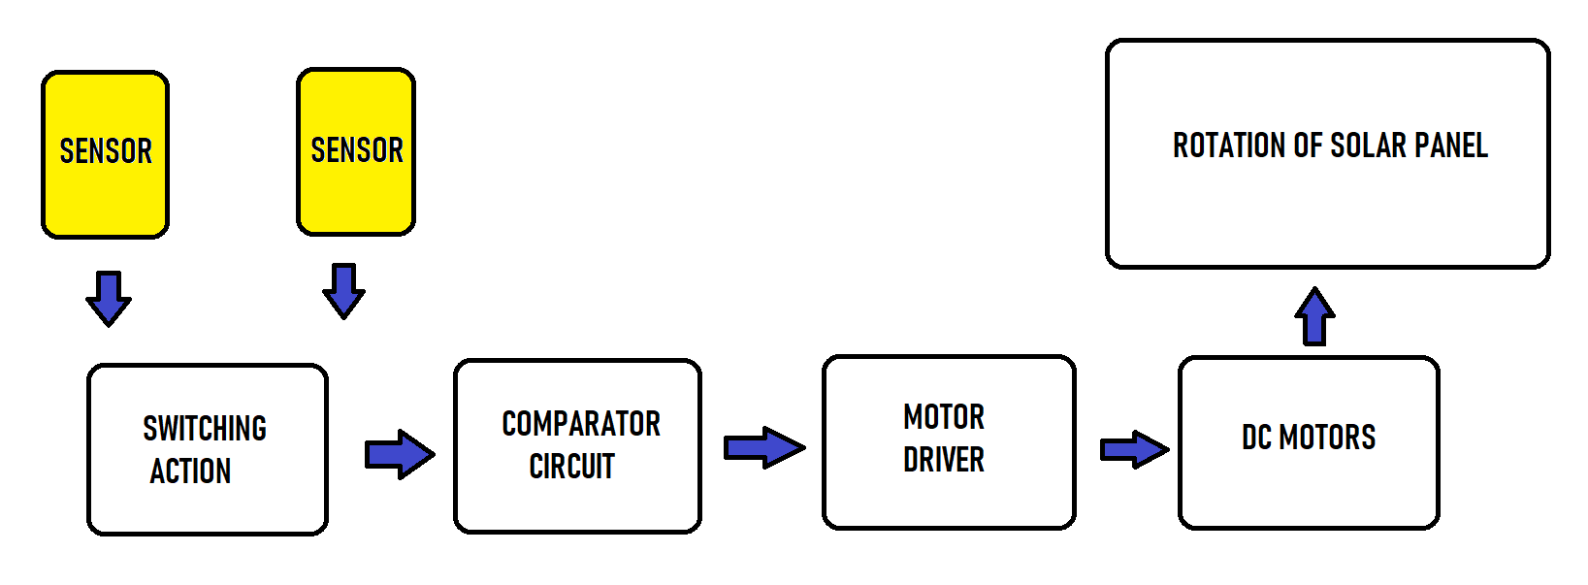
BLOCK DIAGRAM

Slide 11
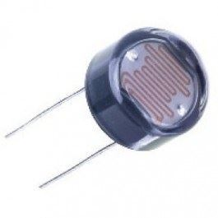
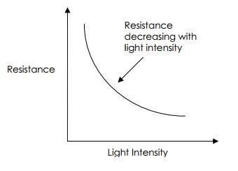
COMPONENTS DESCRIPTION
LDR (Light Dependent Resistor):-
An LDR is a component that has a (variable) resistance that changes with the light intensity that falls upon it. This allows them to be used in light sensing circuits.

Slide 12
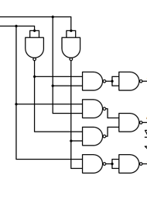
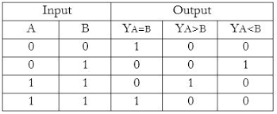
MAGNITUDE COMPARATOR
MAGNITUDE COMPARATOR:
Truth table for 1 Bit Comparator:
^{A}
B
A<B
Y_{A>B}=A.B
Y_{A<B}=A¹.B
Y_{A=B}=A¹.B¹ + A.B
A=B
A>B

Slide 13
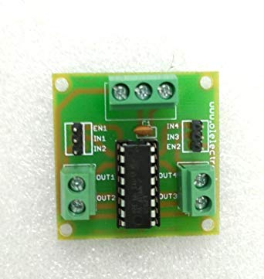
^{MOTOR DRIVER L293D}
L293D is a typical Motor driver or Motor Driver IC which allows DC motor to drive on either direction.L293D is a 16-pin IC which can control a set of two DC motors simultaneously in any direction.

Slide 14
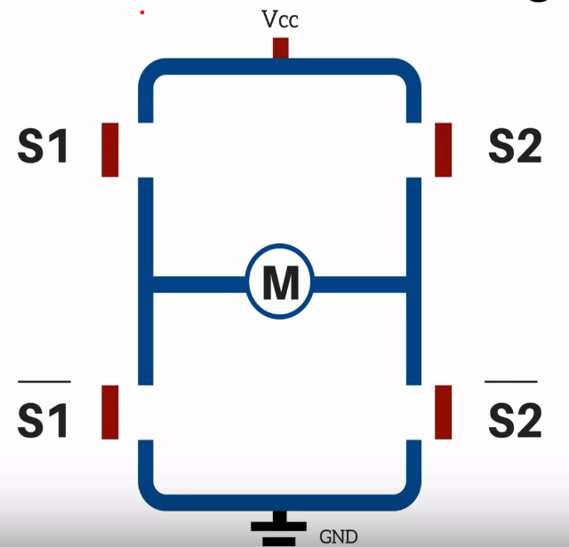
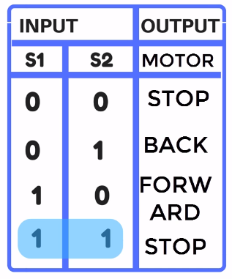
H-Bridge

Slide 15
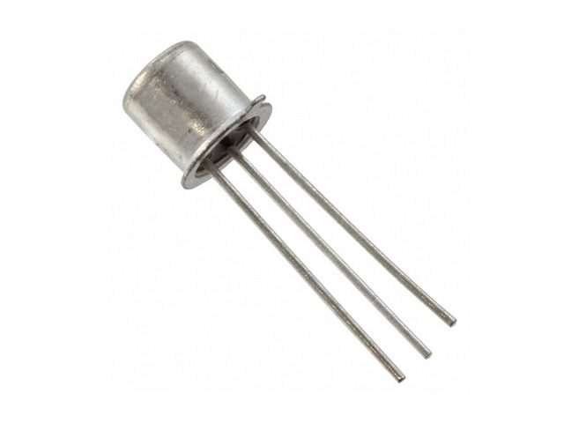
TRANSISTOR(NPN)
A transistor is a semiconductor device used to amplify or switch electronic signals and electrical power. It is composed of semiconductor material usually with at least three terminals for connection to an external circuit.
FIG: BC107 (NPN) Transistor

Slide 16
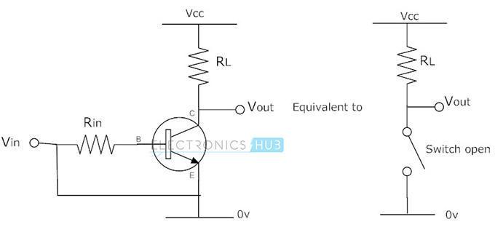
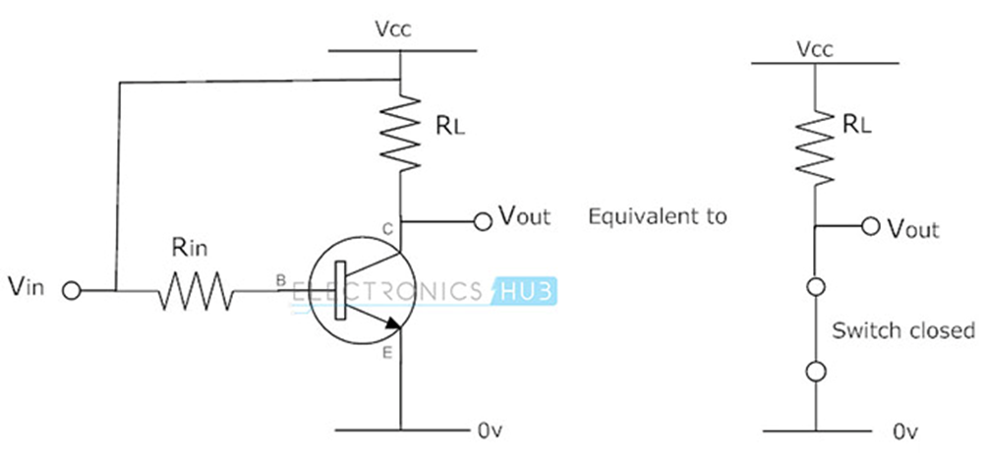
TRANSISTOR AS A SWITCH

Slide 17
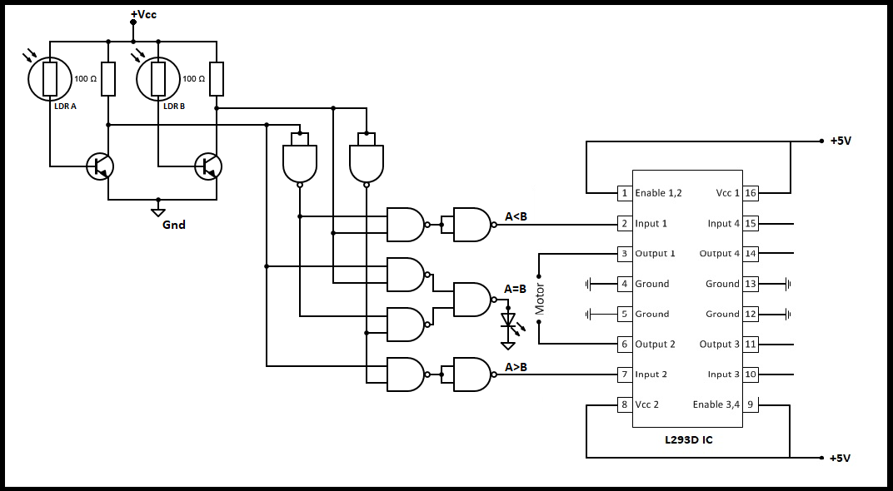
CIRCUIT DIAGRAM

Slide 18
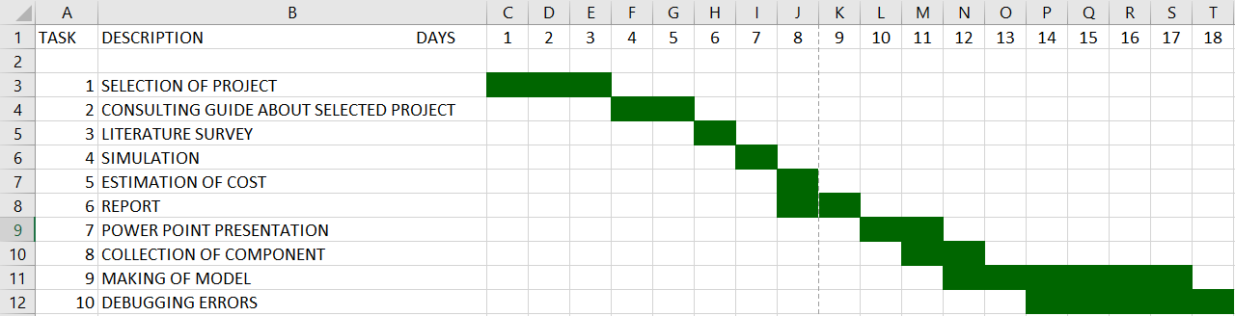
PROJECT PLANNING

Slide 19
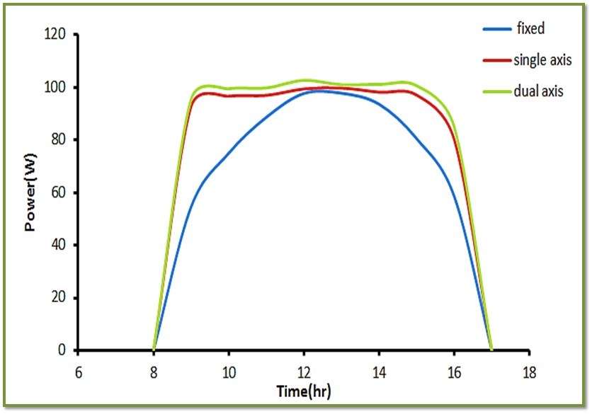
EXPECTED OUTCOMES
The figure below shows experiment done by taking power output vs time from photovoltaic solar systems with different tracking arrangements.
This increase can be as much as 20 to 45% depending on the geographic location of the tracking system.

Slide 20
ADVANTAGES OF USING A SOLAR TRACKER
Solar Tracking systems continually orient PV panels towards the sun and help maximize the investment on PV system.
One time investment ,which provides higher efficiency and flexibility on dependency.
Installation | Fixed | Single-Axis | Double-Axis
Electricity production | A | Increases 20%-30% relative to fixed installation | Increases 60 %relative to fixed installation
Cost | B | Only 10%-15% more than fixed installation | Only 15%-20% more than fixed installation

Slide 21
BUDGET AND PATENTS
PATENTS:
INVENTOR: José Abel González Moreno, Fustifiana (ES)
ASSIGNEE: Mecanizados Solares, S.L., Fustinana (Navarra) (ES)
ESTIMATED BUDGET:
For a standard 4KW system, A axis tracker system costs about Rs 15,40,000 /-
Budget for building the solar tracker for the project is Rs 1000/-

Slide 22
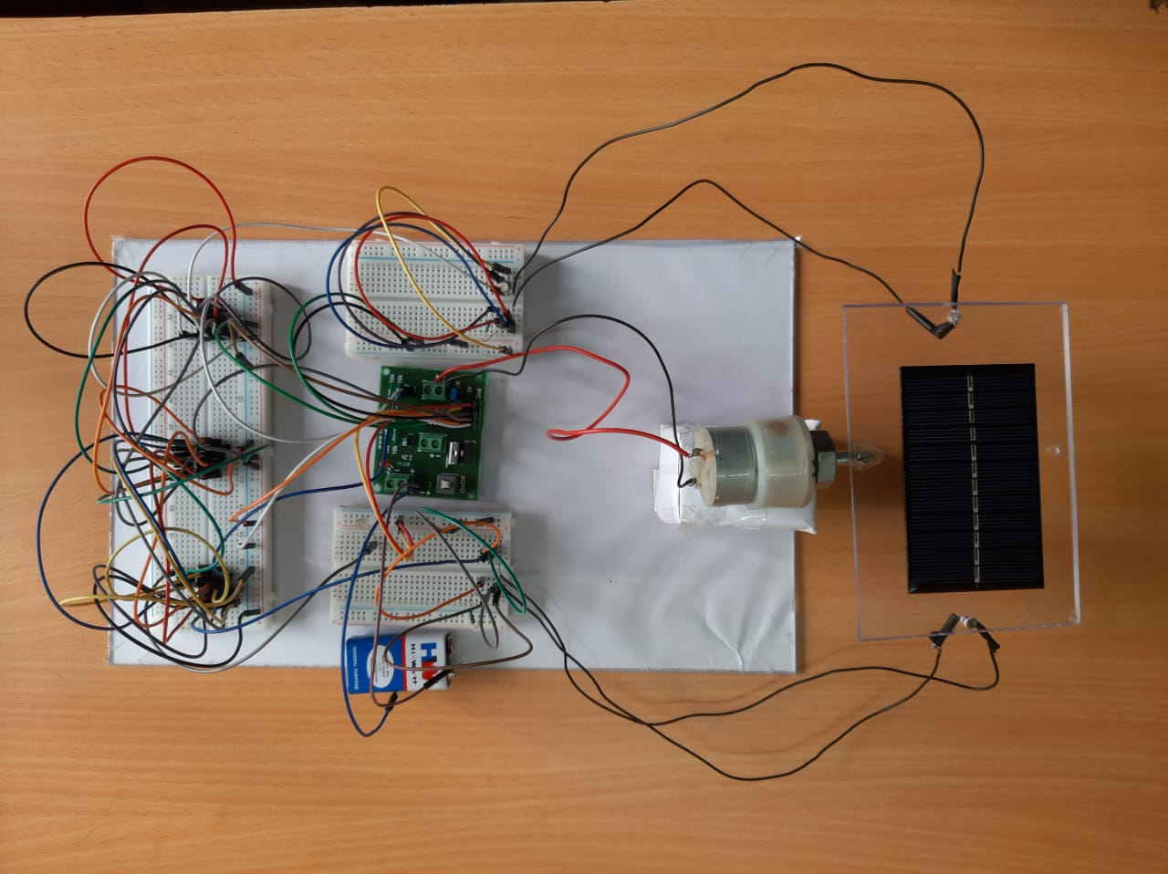
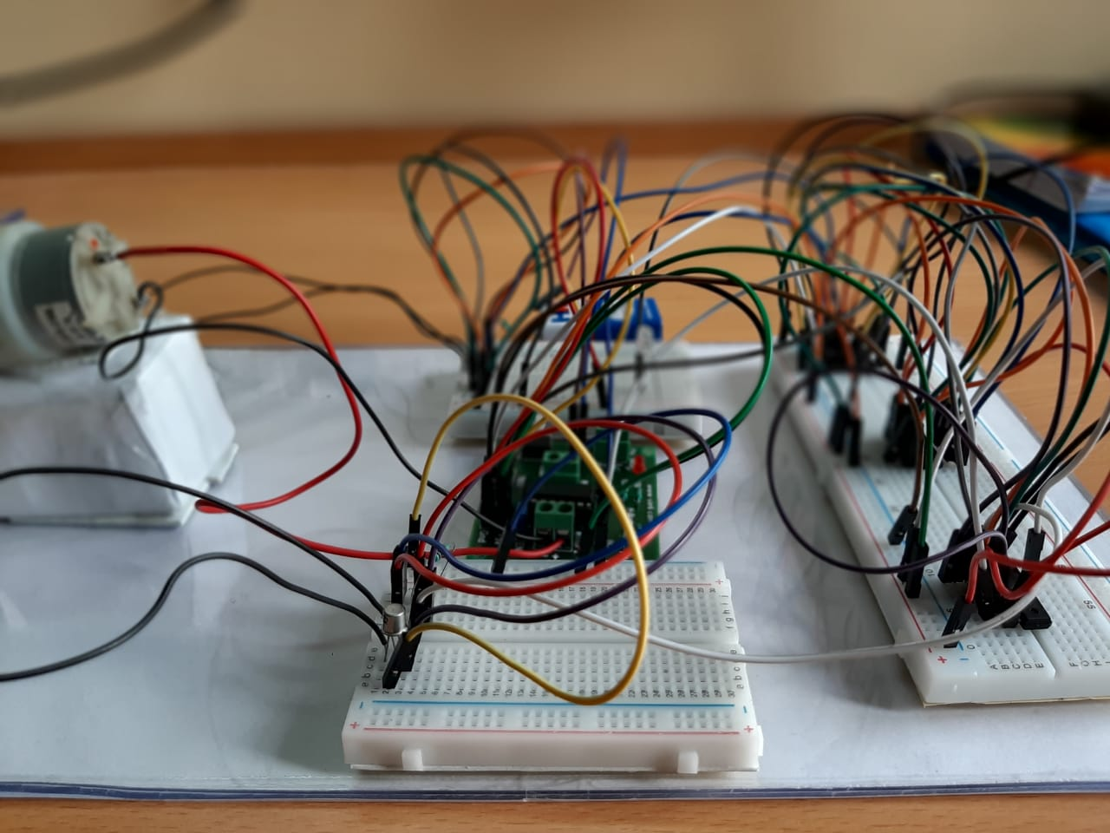
Photos taken during execution

Slide 23
REFERENCE (LITERATURE SURVEY) DETAILS
http://wgbis.ces.iisc.ernet.in/biodiversity/sahyadri_enews/newsletter/issue45/bibliography/Increasing%20the%20solar%20photovoltic%20energy%20capture%20on%20sunny%20and%20cloudy%20days.pdf
http://eprint.iitd.ac.in/bitstream/handle/2074/1708/saxenaver1990.pdf?sequence=2&isAllowed=y
https://www.researchgate.net/publication/3359957_Microprocessor_based_automatic_Sun_tracker
https://www.tandfonline.com/doi/abs/10.1080/01425919808914341
https://www.researchgate.net/publication/3280078_Development_of_a_Microcontroller-Based_Photovoltaic_Maximum_Power_Point_Tracking_Control_System
https://www.researchgate.net/publication/320086210_Solar_Tracking_Techniques_and_Implementation_in_Photovoltaic_Power_Plants_a_Review

Slide 24
THANK YOU

